Slide 1

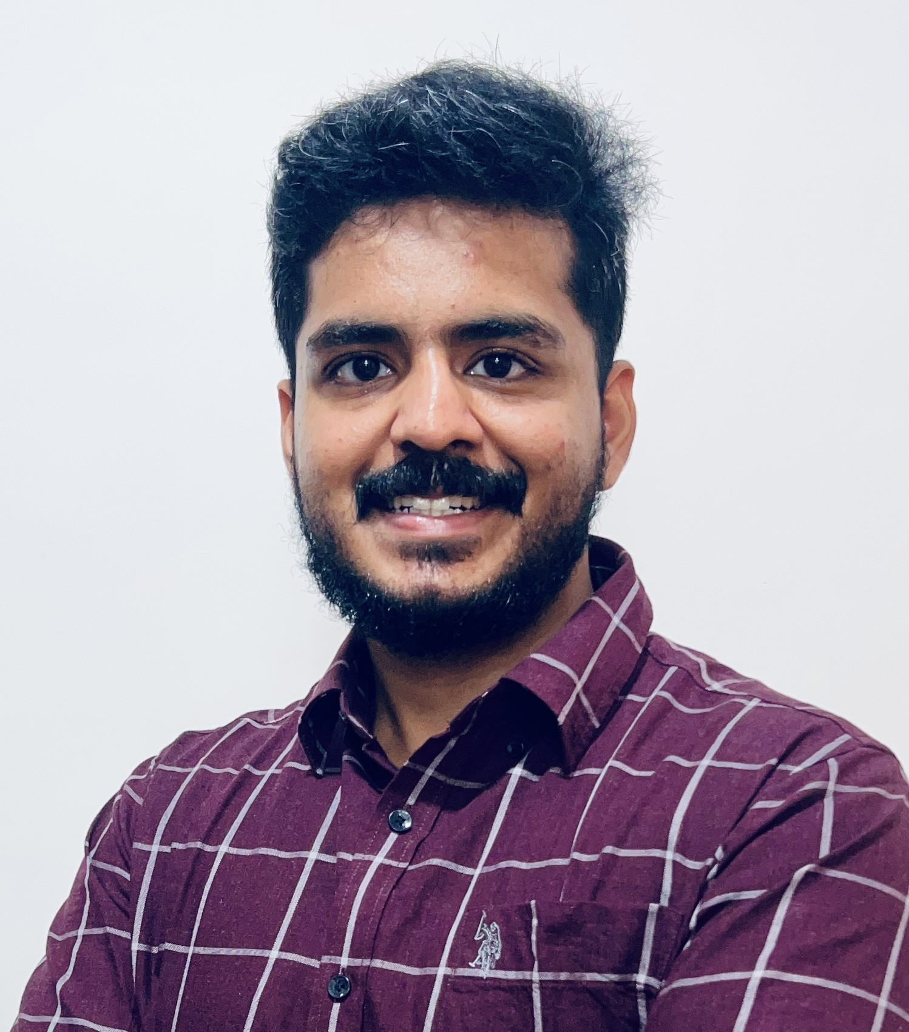

Praven Kumar
Assistant Manager
praven.kumar@genpact.com
+91 8148341952
Bengaluru, KA, India
ABOUT ME
EXPERIENCE
Strategic Data Science & AI professional with expertise in enterprise AI transformation, predictive analytics, and Generative AI enablement.
Experienced in translating complex business challenges into scalable AI solutions that strengthen strategic decision-making and elevate organizational performance. Recognized for bridging business vision with advanced analytics to accelerate enterprise transformation and deliver sustained competitive advantage.
Proficient in Machine Learning, Deep Learning, Computer Vision, NLP, and Agentic AI systems with cloud-native deployment experience.
Enterprise GenAI – RFP Domain Automation
Designed domain-specific AI assistant to automate RFP responses.
• Built SharePoint → GCP ingestion pipeline
• Architected role-based LLM domain for 9 SME functions
• Developed enterprise-grade prompt frameworks
• Enabled conversational knowledge retrieval
Impact: Reduced RFP turnaround time and improved response consistency.
Customer Loyalty Index – Revenue Protection
Developed Random Forest model to predict churn probability.
• Engineered behavioural & revenue features
• Delivered actionable risk segmentation
Impact: Identified 12% high-risk customers; safeguarded $2.5B revenue.
Intelligent Territory Alignment – Sales Optimization
Built Genetic Algorithm model for optimized sales rep alignment.
• Reduced travel inefficiencies
• Balanced revenue allocation
Impact: 350K miles reduction | 10% improvement in revenue distribution.
SKILLS
AI & Machine Learning
Regression, Random Forest, SVM, Multi-label Classification, Predictive Modelling
Deep Learning & Computer Vision
CNN, Object Detection (YOLO), Image Classification, OpenCV
Natural Language Processing & GenAI
LSTM, RNN, Encoder-Decoder, Prompt Engineering, Domain-based LLM Systems
Cloud & MLOps
GCP, Vertex AI, Model Deployment, Pipeline Development
Programming
Python, R
EDUCATION
2012 - 2016
BACHELOR OF ENGINEERING
INDUSTRIES/FUNCTIONS
Sri Ramakrishna Engineering College, Coimbatore
Retail Industry
Healthcare
Finance

